Slide 1
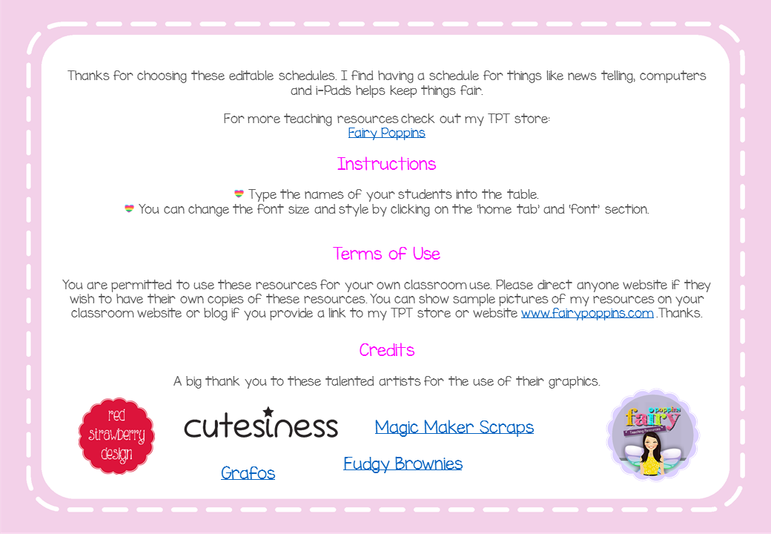

Slide 2
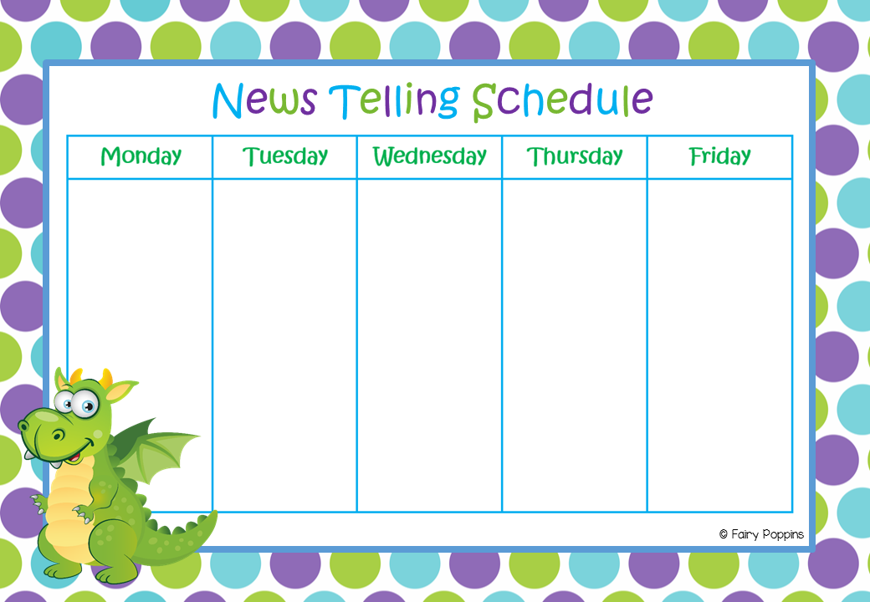
[type here]
[type here]
[type here]
[type here]
[type here]

Slide 3
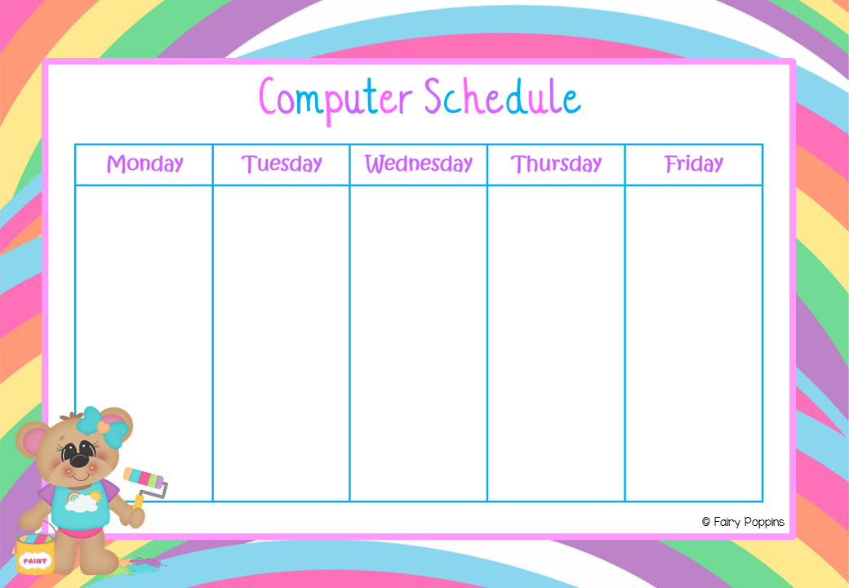
[type here]
[type here]
[type here]
[type here]
[type here]

Slide 4
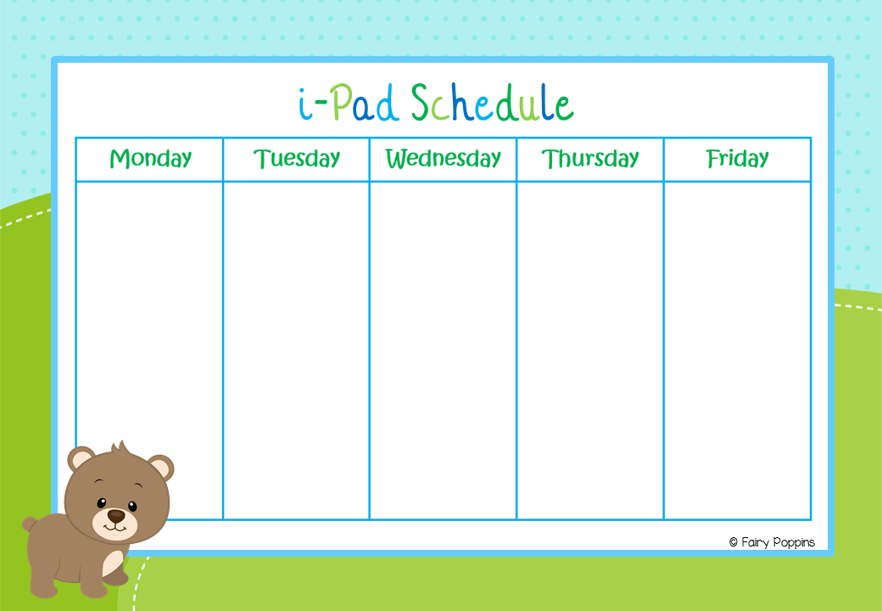
[type here]
[type here]
[type here]
[type here]
[type here]

