Slide 1
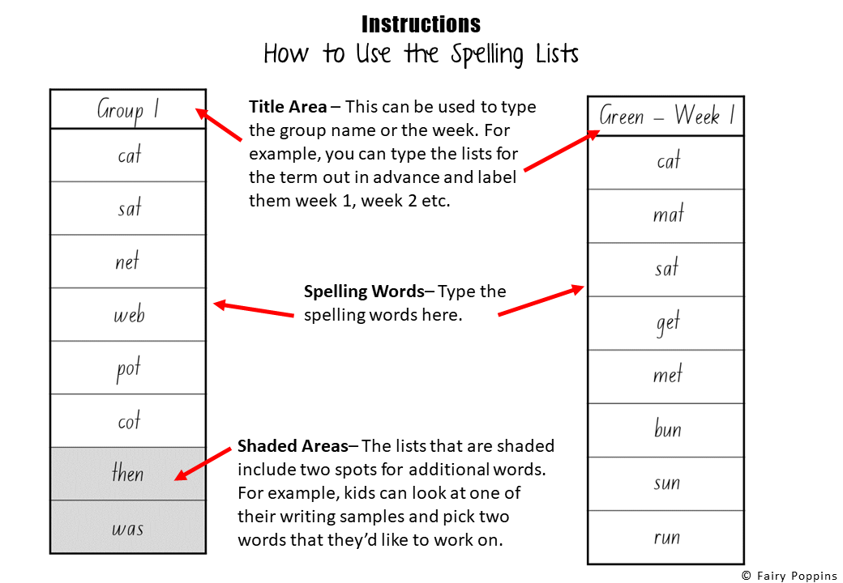

Slide 2
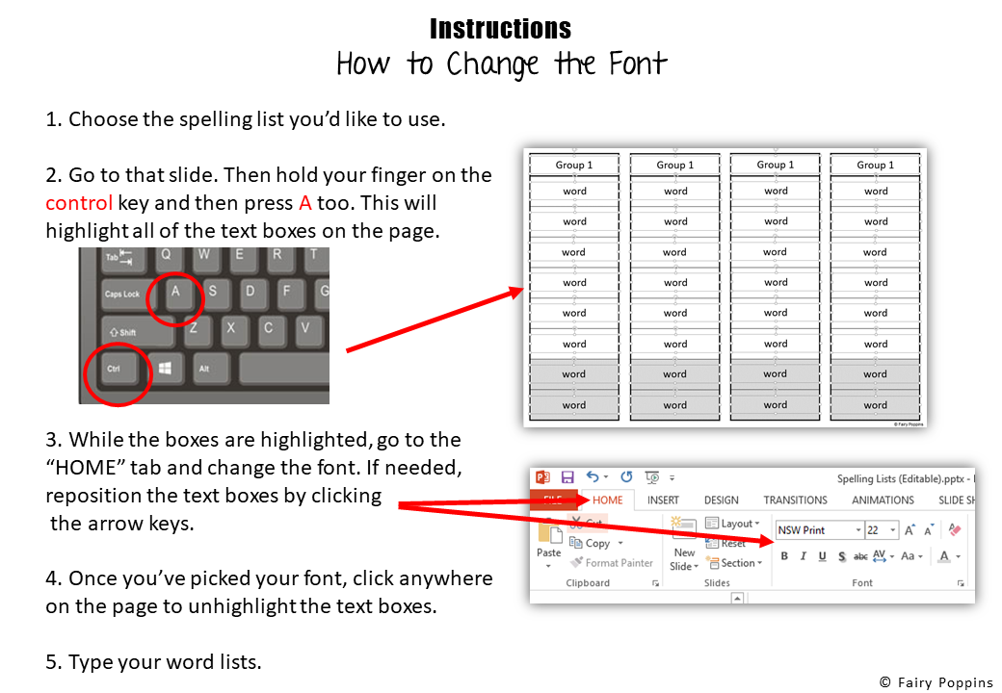

Slide 3
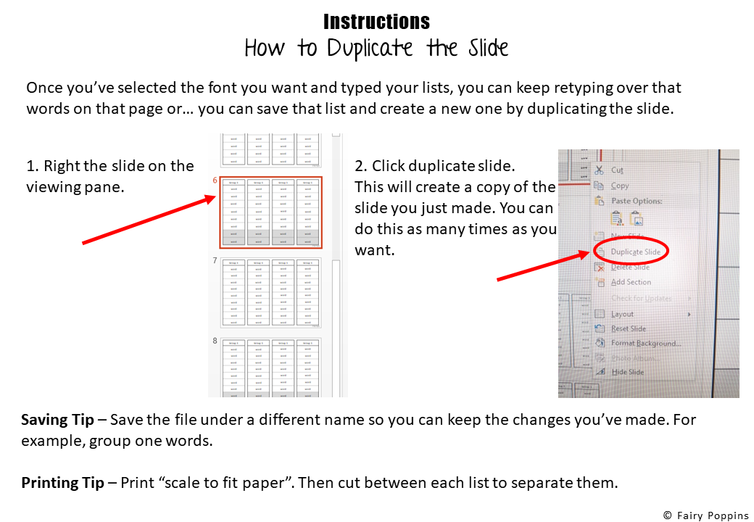

Slide 4

Group 1
Group 1
Group 1
Group 1
word
word
word
word
word
word
word
word
word
word
word
word
word
word
word
word
word
word
word
word
word
word
word
word
word
word
word
word
word
word
word
word

Slide 5
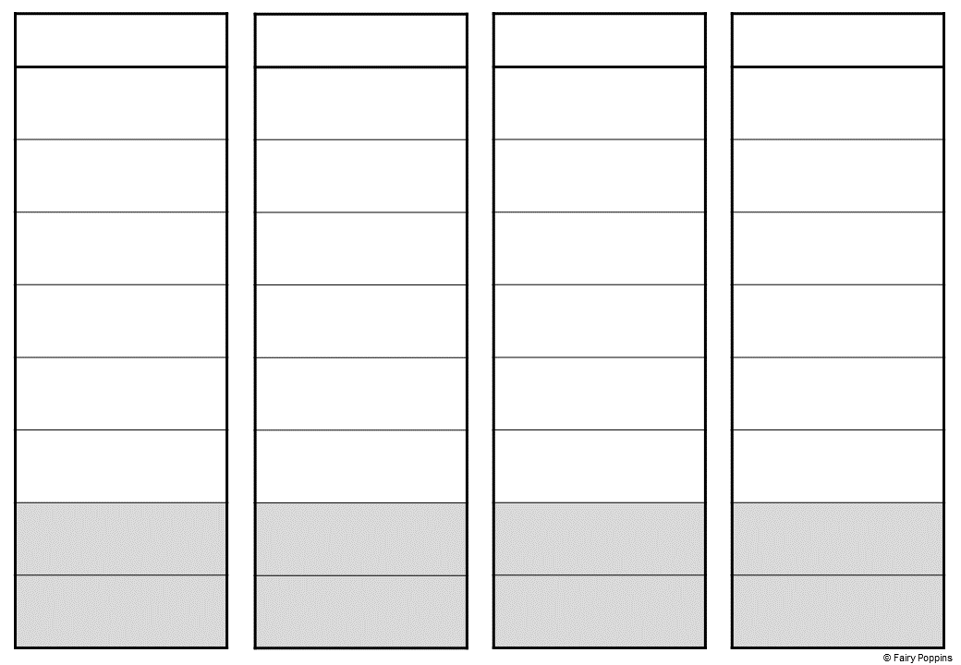
Group 1
Group 1
Group 1
Group 1
word
word
word
word
word
word
word
word
word
word
word
word
word
word
word
word
word
word
word
word
word
word
word
word
word
word
word
word
word
word
word
word

Slide 6

Group 1
Group 1
Group 1
Group 1
word
word
word
word
word
word
word
word
word
word
word
word
word
word
word
word
word
word
word
word
word
word
word
word
word
word
word
word
word
word
word
word
word
word
word
word

Slide 7

Group 1
Group 1
Group 1
Group 1
word
word
word
word
word
word
word
word
word
word
word
word
word
word
word
word
word
word
word
word
word
word
word
word
word
word
word
word
word
word
word
word
word
word
word
word

Slide 8

Group 1
Group 1
Group 1
Group 1
word
word
word
word
word
word
word
word
word
word
word
word
word
word
word
word
word
word
word
word
word
word
word
word
word
word
word
word
word
word
word
word
word
word
word
word
word
word
word
word

Slide 9
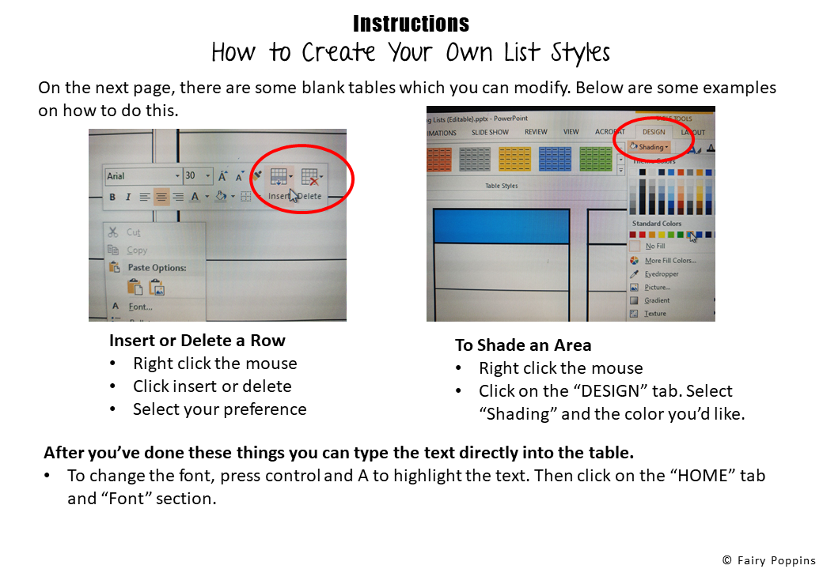

Slide 10
title
word
word
word
word
word
word
word
word
title
word
word
word
word
word
word
word
title
title
word
word
word
word
word
word
word
title
title
word
word
word
word
word
word
word
title

Slide 11
title
word
word
word
word
word
word
word
word
title
word
word
word
word
word
word
word
title
title
word
word
word
word
word
word
word
title
title
word
word
word
word
word
word
word
title

Slide 12
title
word
word
word
word
word
word
word
word
title
word
word
word
word
word
word
word
title
title
word
word
word
word
word
word
word
title
title
word
word
word
word
word
word
word
title

